Slide 1
Unit VI. Cluster Analysis
What is Cluster Analysis?
Types of Data in Cluster Analysis
A Categorization of Major Clustering Methods
Partitioning Methods
Hierarchical Methods (Beyond Curriculum)
Density-Based Methods
Grid-Based Methods
Model-Based Clustering Methods
Outlier Analysis
Text Mining
Web Mining
Summary

Slide 2
What is Cluster Analysis?
Cluster: a collection of data objects
  Similar to one another within the same cluster
  Dissimilar to the objects in other clusters
Cluster analysis
  Grouping a set of data objects into clusters
Clustering is unsupervised classification: no predefined classes
Typical applications
  As a stand-alone tool to get insight into data distribution
  As a preprocessing step for other algorithms

Slide 3
General Applications of Clustering
Pattern Recognition
Spatial Data Analysis
  create thematic maps in GIS by clustering feature spaces
  detect spatial clusters and explain them in spatial data mining
Image Processing
Economic Science (especially market research)
WWW
  Document classification
  Cluster Weblog data to discover groups of similar access patterns

Slide 4
Examples of Clustering Applications
Marketing: Help marketers discover distinct groups in their customer bases, and then use this knowledge to develop targeted mktg. programs
Land use: Identification of areas of similar land use in an earth observation db.
Insurance: Identifying groups of motor insurance policy holders with a high average claim cost
City-planning: Identifying groups of houses according to their house type, value, and geographical location
Earth-quake studies: Observed earth quake epicenters should be clustered along continent faults

Slide 5
What Is Good Clustering?
A good clustering method will produce high quality clusters with
  high intra-class similarity
  low inter-class similarity
The quality of a clustering result depends on both the similarity measure used by the method and its implementation.
The quality of a clustering method is also measured by its ability to discover some or all of the hidden patterns.

Slide 6
Requirements of Clustering in Data Mining
Scalability
Ability to deal with different types of attributes
Discovery of clusters with arbitrary shape
Minimal requirements for domain knowledge to determine input parameters
Able to deal with noise and outliers
Insensitive to order of input records
High dimensionality
Incorporation of user-specified constraints
Interpretability and usability

Slide 7
Chapter 8. Cluster Analysis
What is Cluster Analysis?
Types of Data in Cluster Analysis
A Categorization of Major Clustering Methods
Partitioning Methods
Hierarchical Methods
Density-Based Methods
Grid-Based Methods
Model-Based Clustering Methods
Outlier Analysis
Summary

Slide 8


Data Structures
Data matrix-
Object by Variable
  (two modes)
Dissimilarity matrix
  (one mode)

Slide 9
Measure the Quality of Clustering
Dissimilarity/Similarity metric: Similarity is expressed in terms of a distance function, which is typically metric: d(i, j)
There is a separate “quality” function that measures the “goodness” of a cluster.
The definitions of distance functions are usually very different for interval-scaled, boolean, categorical, ordinal and ratio variables.
Weights should be associated with different variables based on applications and data semantics.
It is hard to define “similar enough” or “good enough”
  the answer is typically highly subjective.

Slide 10
Type of data in clustering analysis
Interval-scaled variables:
Binary variables:
Nominal, ordinal, and ratio variables:
Variables of mixed types:

Slide 11
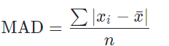
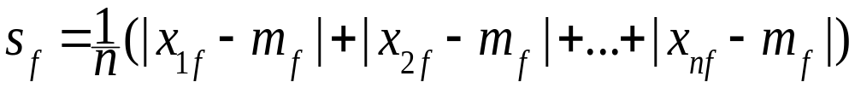
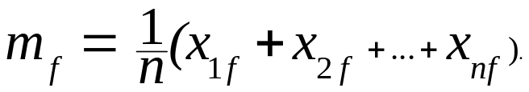
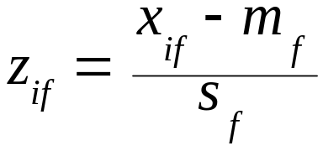
Interval-valued variables
Standardize data
  Calculate the mean absolute deviation (MAD):
  where
  Calculate the standardized measurement (z-score)
Using mean absolute deviation is more robust than using standard deviation

Slide 12


Similarity and Dissimilarity Between Objects
Distances are normally used to measure the similarity or dissimilarity between two data objects
Some popular ones include: Minkowski distance:
  where i = (x_{i1}, x_{i2}, …, x_{ip}) and j = (x_{j1}, x_{j2}, …, x_{jp}) are two p-dimensional data objects, and q is a positive integer
If q = 1, d is Manhattan distance

Slide 13

Similarity and Dissimilarity Between Objects (Cont.)
If q = 2, d is Euclidean distance:
  Properties
    d(i,j) ≥ 0
    d(i,i) = 0
    d(i,j) = d(j,i)
    d(i,j) ≤ d(i,k) + d(k,j)
Also one can use weighted distance, parametric Pearson product moment correlation, or other disimilarity measures.

Slide 14



Binary Variables
A contingency table for binary data
Simple matching coefficient (invariant, if the binary variable is symmetric):
Jaccard coefficient (noninvariant if the binary variable is asymmetric):
Object j
Object i

Slide 15


Dissimilarity between Binary Variables
Example
  gender is a symmetric attribute
  the remaining attributes are asymmetric binary
  let the values Y and P be set to 1, and the value N be set to 0

Slide 16

Nominal Variables
A generalization of the binary variable in that it can take more than 2 states, e.g., red, yellow, blue, green
Method 1: Simple matching
  m: # of matches, p: total # of variables
Method 2: use a large number of binary variables
  creating a new binary variable for each of the M nominal states

Slide 17


Ordinal Variables
An ordinal variable can be discrete or continuous
order is important, e.g., rank
Can be treated like interval-scaled
  replacing x_{if} by their rank
  map the range of each variable onto [0, 1] by replacing i-th object in the f-th variable by
  compute the dissimilarity using methods for interval-scaled variables

Slide 18
Ratio-Scaled Variables
Ratio-scaled variable: a positive measurement on a nonlinear scale, approximately at exponential scale, such as Ae^{Bt} or Ae^{-Bt}
Methods:
  treat them like interval-scaled variables — not a good choice! (why?)
  apply logarithmic transformation
y_{if} = log(x_{if})
  treat them as continuous ordinal data treat their rank as interval-scaled.

Slide 19

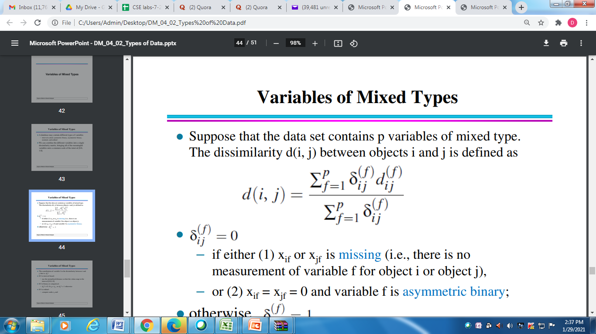

Variables of Mixed Types
A database may contain all the six types of variables
  symmetric binary, asymmetric binary, nominal, ordinal, interval and ratio.
One may use a weighted formula to combine their effects.
  f is binary or nominal:
    d_{ij}^{(f)} = 0 if x_{if} = x_{jf} or missing values, or d_{ij}^{(f)} = 1 o.w.
  f is interval-based: use the normalized distance
  f is ordinal or ratio-scaled
    compute ranks r_{if} and
    and treat z_{if} as interval-scaled

Slide 20
Chapter 8. Cluster Analysis
What is Cluster Analysis?
Types of Data in Cluster Analysis
A Categorization of Major Clustering Methods
Partitioning Methods
Density-Based Methods
Grid-Based Methods
Model-Based Clustering Methods
Outlier Analysis
Summary

Slide 21
Major Clustering Approaches
Partitioning algorithms: Construct various partitions and then evaluate them by some criterion
Hierarchy algorithms: Create a hierarchical decomposition of the set of data (or objects) using some criterion
Density-based: based on connectivity and density functions
Grid-based: based on a multiple-level granularity structure
Model-based: A model is hypothesized for each of the clusters and the idea is to find the best fit of that model to each other

Slide 22
Chapter 8. Cluster Analysis
What is Cluster Analysis?
Types of Data in Cluster Analysis
A Categorization of Major Clustering Methods
  Partitioning Methods
  Hierarchical Methods
  Density-Based Methods
  Grid-Based Methods
  Model-Based Clustering Methods
  Outlier Analysis
Summary

Slide 23
Partitioning Algorithms: Basic Concept
Partitioning method: Construct a partition of a database D of n objects into a set of k clusters
Given a k, find a partition of k clusters that optimizes the chosen partitioning criterion
  Global optimal: exhaustively enumerate all partitions
  Heuristic methods: k-means and k-medoids algorithms
  k-means (MacQueen’67): Each cluster is represented by the center of the cluster
  k-medoids or PAM (Partition around medoids) (Kaufman & Rousseeuw’87): Each cluster is represented by one of the objects in the cluster

Slide 24
The K-Means Clustering Method
Given k, the k-means algorithm is implemented in 4 steps:
  Partition objects into k nonempty subsets
  Compute seed points as the centroids of the clusters of the current partition. The centroid is the center (mean point) of the cluster.
  Assign each object to the cluster with the nearest seed point.
  Go back to Step 2, stop when no more new assignment.

Slide 25


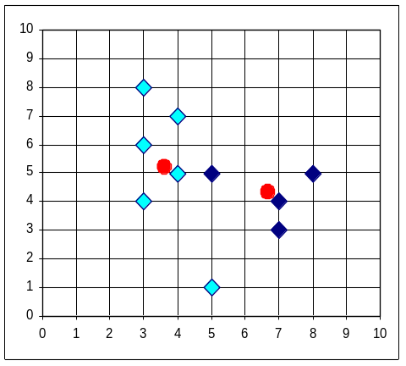


The K-Means Clustering Method

Slide 26
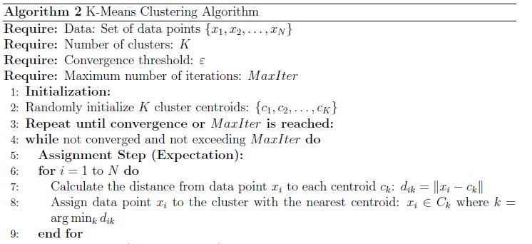
K-Means Clustering

Slide 27
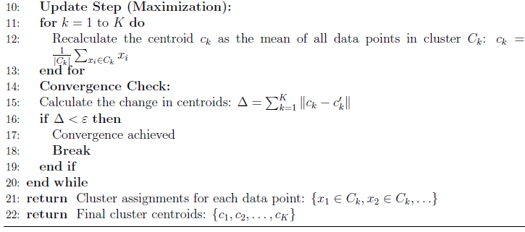

Slide 28
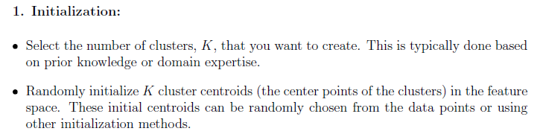
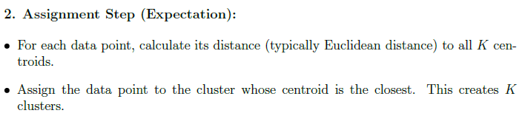

Slide 29
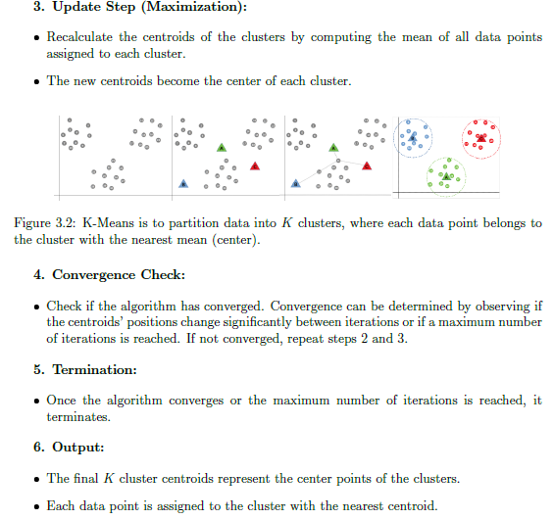

Slide 30
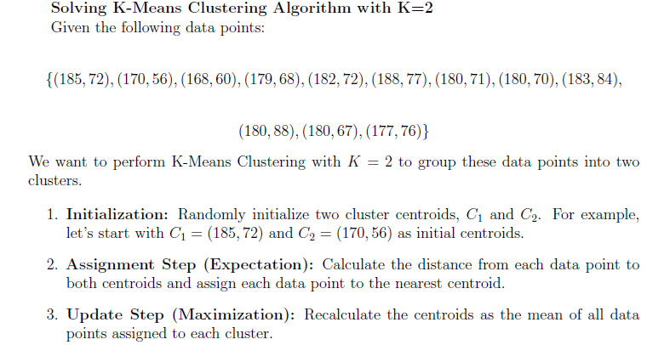

Slide 31
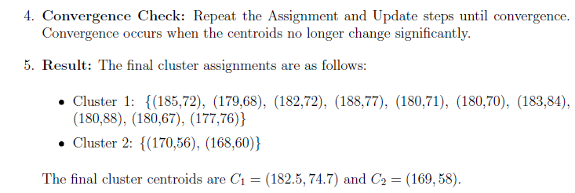

Slide 32
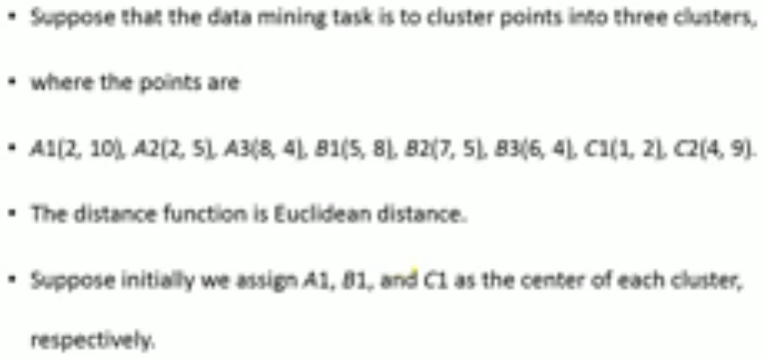

Slide 33
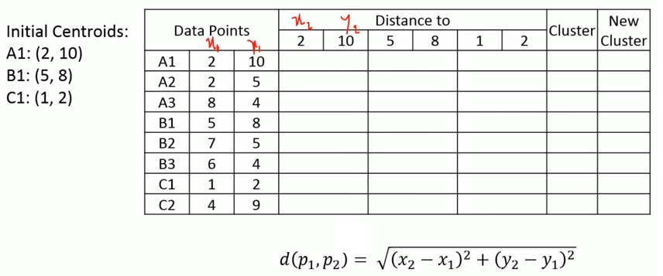

Slide 34
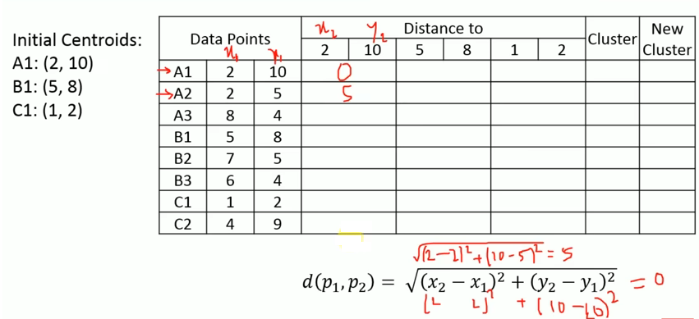

Slide 35
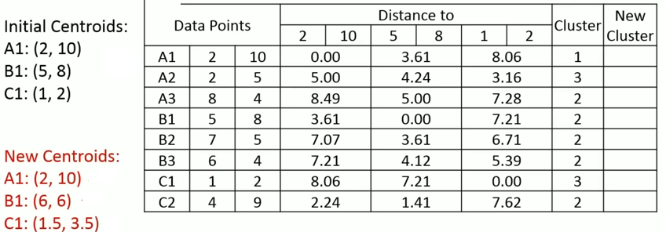

Slide 36
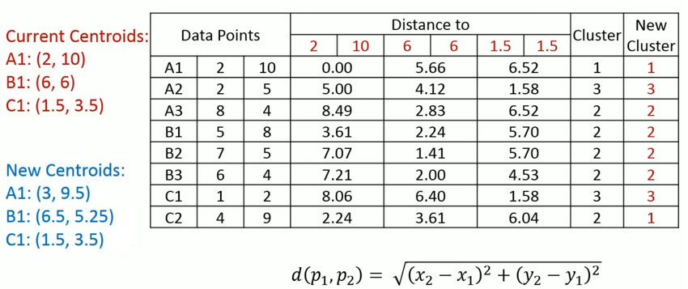

Slide 37
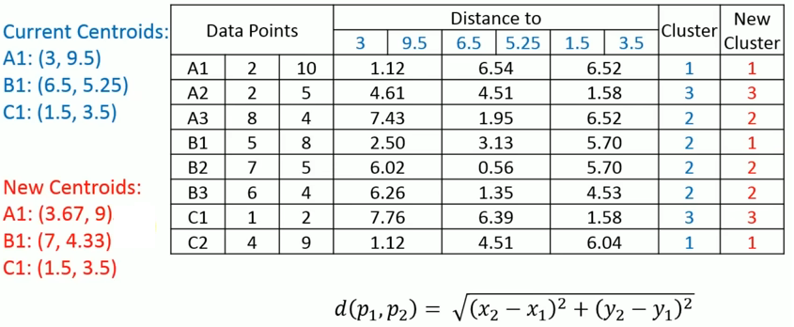

Slide 38
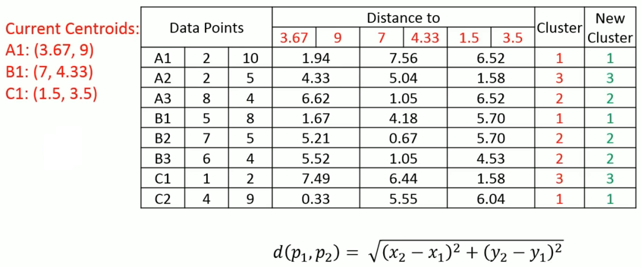

Slide 39
Comments on the K-Means Method
Strength
  Relatively efficient: O(tkn), where n is # objects, k is # clusters, and t is # iterations. Normally, k, t << n.
  Often terminates at a local optimum. The global optimum may be found using techniques such as: deterministic annealing and genetic algorithms
Weakness
  Applicable only when mean is defined, then what about categorical data?
  Need to specify k, the number of clusters, in advance
  Unable to handle noisy data and outliers
  Not suitable to discover clusters with non-convex shapes

Slide 40
Variations of the K-Means Method
A few variants of the k-means which differ in
  Selection of the initial k means
  Dissimilarity calculations
  Strategies to calculate cluster means
Handling categorical data: k-modes (Huang’98)
  Replacing means of clusters with modes
  Using new dissimilarity measures to deal with categorical objects
  Using a frequency-based method to update modes of clusters
  A mixture of categorical and numerical data: k-prototype method

Slide 41
The K-Medoids Clustering Method
Find representative objects, called medoids, in clusters
PAM (Partitioning Around Medoids, 1987)
  starts from an initial set of medoids and iteratively replaces one of the medoids by one of the non-medoids if it improves the total distance of the resulting clustering
  PAM works effectively for small data sets, but does not scale well for large data sets
CLARA (Kaufmann & Rousseeuw, 1990)
CLARANS (Ng & Han, 1994): Randomized sampling
Focusing + spatial data structure (Ester et al., 1995)

Slide 42
PAM (Partitioning Around Medoids) (1987)
PAM (Kaufman and Rousseeuw, 1987), built in Splus
Use real object to represent the cluster
  Select k representative objects arbitrarily
  For each pair of non-selected object h and selected object i, calculate the total swapping cost TC_{ih}
  For each pair of i and h,
    If TC_{ih} < 0, i is replaced by h
    Then assign each non-selected object to the most similar representative object
  repeat steps 2-3 until there is no change

Slide 43

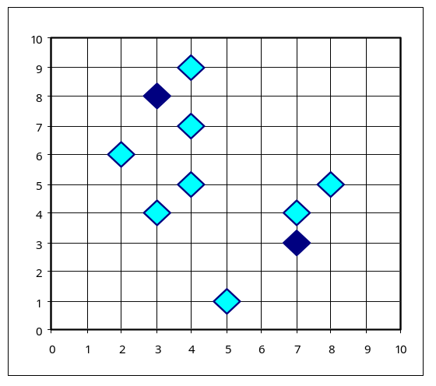
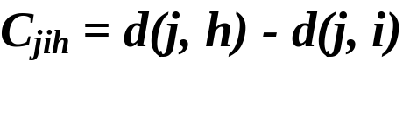

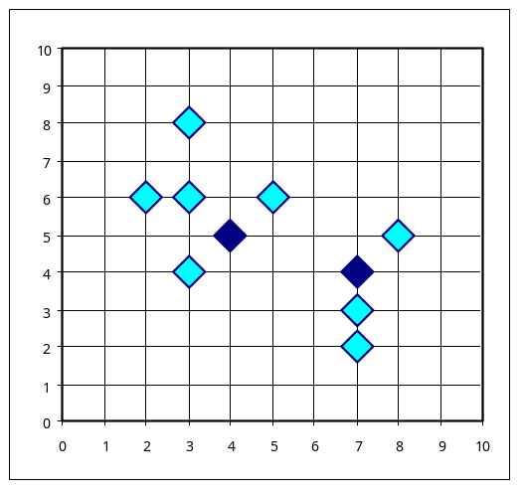
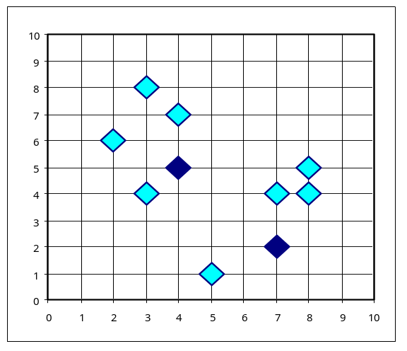


PAM Clustering: Total swapping cost TC_{ih}=∑_{j}C_{jih}
t
j
t
j
i
h
h
i
h
j
i
i
t
h
j
t

Slide 44
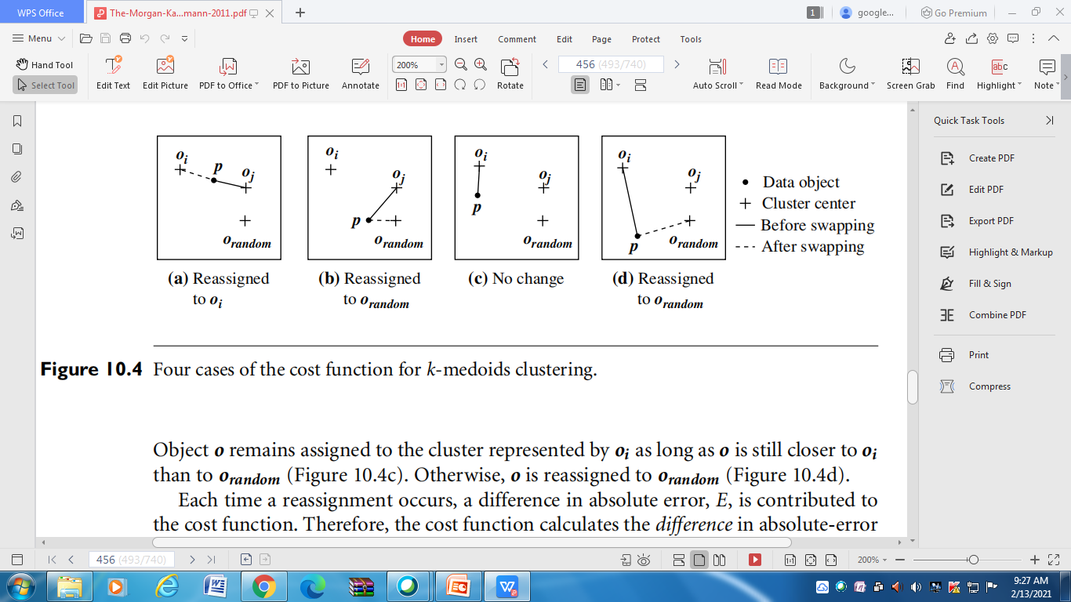
4 cases of K- Medoids Clustering

Slide 45
CLARA (Clustering Large Applications) (1990)
CLARA (Kaufmann and Rousseeuw in 1990)
  Built in statistical analysis packages, such as S+
It draws multiple samples of the data set, applies PAM on each sample, and gives the best clustering as the output
Strength: deals with larger data sets than PAM
Weakness:
  Efficiency depends on the sample size
  A good clustering based on samples will not necessarily represent a good clustering of the whole data set if the sample is biased

Slide 46
CLARANS (“Randomized” CLARA) (1994)
CLARANS (A Clustering Algorithm based on Randomized Search) (Ng and Han’94)
CLARANS draws sample of neighbors dynamically
The clustering process can be presented as searching a graph where every node is a potential solution, that is, a set of k medoids
If the local optimum is found, CLARANS starts with new randomly selected node in search for a new local optimum
It is more efficient and scalable than both PAM and CLARA
Focusing techniques and spatial access structures may further improve its performance (Ester et al.’95)

Slide 47
Chapter 8. Cluster Analysis
What is Cluster Analysis?
Types of Data in Cluster Analysis
A Categorization of Major Clustering Methods
Partitioning Methods
Density-Based Methods
Grid-Based Methods
Model-Based Clustering Methods
Outlier Analysis
Summary

Slide 48
Density-Based Clustering Methods
Clustering based on density (local cluster criterion), such as density-connected points
Major features:
  Discover clusters of arbitrary shape
  Handle noise
  One scan
  Need density parameters as termination condition
Several interesting studies:
  DBSCAN: Ester, et al. (KDD’96)
  OPTICS: Ankerst, et al (SIGMOD’99).
  DENCLUE: Hinneburg & D. Keim (KDD’98)
  CLIQUE: Agrawal, et al. (SIGMOD’98)

Slide 49
Density-Based Clustering: Background
Two parameters:
  Eps: Maximum radius of the neighbourhood
  MinPts: Minimum number of points in an Eps-neighbourhood of that point
N_{Eps}(p): {q belongs to D | dist(p,q) <= Eps}
Directly density-reachable: A point p is directly density-reachable from a point q wrt. Eps, MinPts if
  1) p belongs to N_{Eps}(q)
  2) core point condition:
  |N_{Eps} (q)| >= MinPts
p
MinPts = 5
Eps = 1 cm
q

Slide 50
Density-Based Clustering: Background (II)
Density-reachable:
  A point p is density-reachable from a point q wrt. Eps, MinPts if there is a chain of points p₁, …, p_{n}, p₁ = q, p_{n} = p such that p_{i+1} is directly density-reachable from p_{i}
Density-connected
  A point p is density-connected to a point q wrt. Eps, MinPts if there is a point o such that both, p and q are density-reachable from o wrt. Eps and MinPts.
p
p₁
q
p
q
o

Slide 51
DBSCAN: Density Based Spatial Clustering of Applications with Noise
Relies on a density-based notion of cluster: A cluster is defined as a maximal set of density-connected points
Discovers clusters of arbitrary shape in spatial databases with noise
Outlier
Border
Eps = 1cm
MinPts = 5
Core

Slide 52
DBSCAN: The Algorithm
  Arbitrary select a point p
  Retrieve all points density-reachable from p wrt Eps and MinPts.
  If p is a core point, a cluster is formed.
  If p is a border point, no points are density-reachable from p and DBSCAN visits the next point of the database.
  Continue the process until all of the points have been processed.

Slide 53
OPTICS: A Cluster-Ordering Method (1999)
OPTICS: Ordering Points To Identify the Clustering Structure
  Produces a special order of the database wrt its density-based clustering structure
  This cluster-ordering contains info equiv to the density-based clusterings corresponding to a broad range of parameter settings
  Good for both automatic and interactive cluster analysis, including finding intrinsic clustering structure
  Can be represented graphically or using visualization techniques

Slide 54
OPTICS: Some Extension from DBSCAN
Index-based:
    k = number of dimensions
    N = 20
    p = 75%
    M = N(1-p) = 5
  Complexity: O(kN²)
Core Distance
Reachability Distance
D
p1
o
p2
o
Max (core-distance (o), d (o, p))
r(p1, o) = 2.8cm. r(p2,o) = 4cm
MinPts = 5
ε = 3 cm

Slide 55


Reachability-distance
undefined
‘
Cluster-order
of the objects

Slide 56
DENCLUE: using density functions
DENsity-based CLUstEring by Hinneburg & Keim (KDD’98)
Major features
  Solid mathematical foundation
  Good for data sets with large amounts of noise
  Allows a compact mathematical description of arbitrarily shaped clusters in high-dimensional data sets
  Significant faster than existing algorithm (faster than DBSCAN by a factor of up to 45)
  But needs a large number of parameters

Slide 57
Denclue: Technical Essence
Uses grid cells but only keeps information about grid cells that do actually contain data points and manages these cells in a tree-based access structure.
Influence function: describes the impact of a data point within its neighborhood.
Overall density of the data space can be calculated as the sum of the influence function of all data points.
Clusters can be determined mathematically by identifying density attractors.
Density attractors are local maximal of the overall density function.

Slide 58
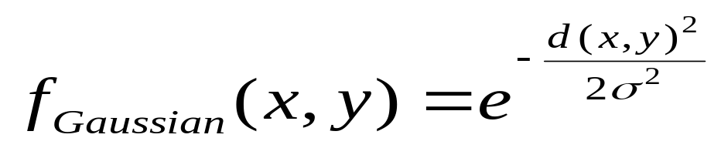
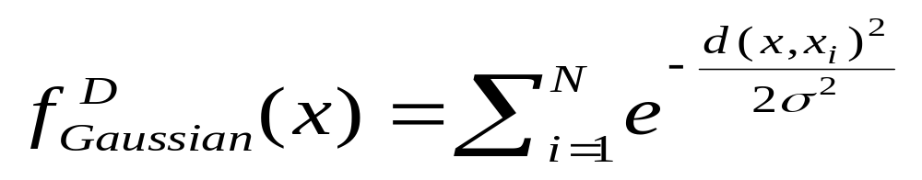

Gradient: The steepness of a slope
Example

Slide 59
Chapter 8. Cluster Analysis
What is Cluster Analysis?
Types of Data in Cluster Analysis
A Categorization of Major Clustering Methods
Partitioning Methods
Hierarchical Methods
Density-Based Methods
Grid-Based Methods
Model-Based Clustering Methods
Outlier Analysis
Summary

Slide 60
Grid-Based Clustering Method
Using multi-resolution grid data structure
Several interesting methods
  STING (a STatistical INformation Grid approach) by Wang, Yang and Muntz (1997)
  WaveCluster by Sheikholeslami, Chatterjee, and Zhang (VLDB’98)
    A multi-resolution clustering approach using wavelet method
  CLIQUE: Agrawal, et al. (SIGMOD’98)

Slide 61
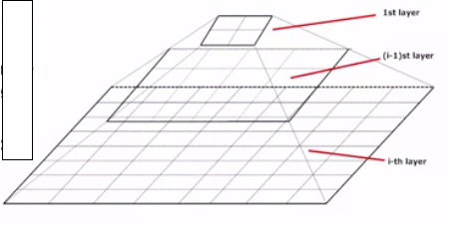
STING: A Statistical Information Grid Approach
The spatial area area is divided into rectangular cells
There are several levels of cells corresponding to different levels of resolution

Slide 62
STING: A Statistical Information Grid Approach (2)
  Each cell at a high level is partitioned into a number of smaller cells in the next lower level
  Statistical info of each cell is calculated and stored beforehand and is used to answer queries
  Parameters of higher level cells can be easily calculated from parameters of lower level cell
    count, mean, s, min, max
    type of distribution—normal, uniform, etc.
  Use a top-down approach to answer spatial data queries
  Start from a pre-selected layer—typically with a small number of cells
  For each cell in the current level compute the confidence interval

Slide 63
STING: A Statistical Information Grid Approach (3)
  Remove the irrelevant cells from further consideration
  When finish examining the current layer, proceed to the next lower level
  Repeat this process until the bottom layer is reached
  Advantages:
    Query-independent, easy to parallelize, incremental update
    O(K), where K is the number of grid cells at the lowest level
  Disadvantages:
    All the cluster boundaries are either horizontal or vertical, and no diagonal boundary is detected

Slide 64
WaveCluster (1998)
A multi-resolution clustering approach which applies wavelet transform to the feature space
  A wavelet transform is a signal processing technique that decomposes a signal into different frequency sub-band.
Both grid-based and density-based
Input parameters:
  # of grid cells for each dimension
  the wavelet, and the # of applications of wavelet transform.

Slide 65
WaveCluster (1998)
Why is wavelet transformation useful for clustering
  Unsupervised clustering
  It uses hat-shape filters to emphasize region where points cluster, but simultaneously to suppress weaker information in their boundary
  Effective removal of outliers
  Multi-resolution
  Cost efficiency
Major features:
  Complexity O(N)
  Detect arbitrary shaped clusters at different scales
  Not sensitive to noise, not sensitive to input order
  Only applicable to low dimensional data

Slide 66
CLIQUE (Clustering In QUEst)
Automatically identifying subspaces of a high dimensional data space that allow better clustering than original space
CLIQUE can be considered as both density-based and grid-based
  It partitions each dimension into the same number of equal length interval
  It partitions an m-dimensional data space into non-overlapping rectangular units
  A unit is dense if the fraction of total data points contained in the unit exceeds the input model parameter
  A cluster is a maximal set of connected dense units within a subspace

Slide 67
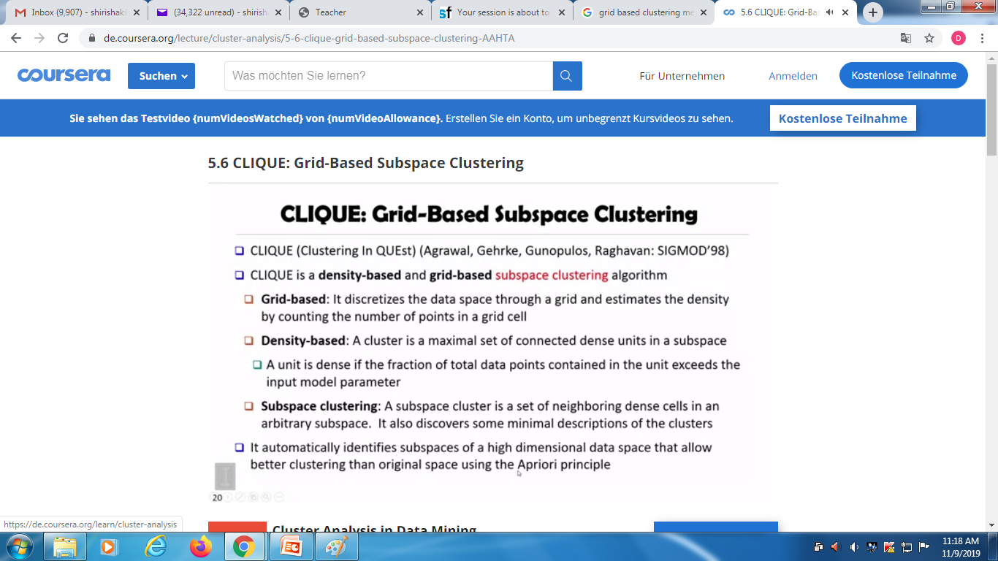

Slide 68
CLIQUE: The Major Steps
Partition the data space and find the number of points that lie inside each cell of the partition.
Identify the subspaces that contain clusters using the Apriori principle
Identify clusters:
  Determine dense units in all subspaces of interests
  Determine connected dense units in all subspaces of interests.
Generate minimal description for the clusters
  Determine maximal regions that cover a cluster of connected dense units for each cluster
  Determination of minimal cover for each cluster

Slide 69
Salary (10,000)
Vacation(week)
7
7
6
6
5
5
4
4
3
3
2
2
1
1
0
age
0
age
20
30
40
50
60
20
30
40
50
60
τ = 3
Vacation
Salary
30
50
age

Slide 70
Strength and Weakness of CLIQUE
Strength
  It automatically finds subspaces of the highest dimensionality such that high density clusters exist in those subspaces
  It is insensitive to the order of records in input and does not presume some canonical data distribution
  It scales linearly with the size of input and has good scalability as the number of dimensions in the data increases
Weakness
  The accuracy of the clustering result may be degraded at the expense of simplicity of the method

Slide 71
Chapter 8. Cluster Analysis
What is Cluster Analysis?
Types of Data in Cluster Analysis
A Categorization of Major Clustering Methods
Partitioning Methods
Density-Based Methods
Grid-Based Methods
Model-Based Clustering Methods
Outlier Analysis
Summary

Slide 72
Model-Based Clustering Methods
Attempt to optimize the fit between the data and some mathematical model
Statistical and AI approach
  Conceptual clustering
    A form of clustering in machine learning
    Produces a classification scheme for a set of unlabeled objects
    Finds characteristic description for each concept (class)
  COBWEB (Fisher’87)
    A popular a simple method of incremental conceptual learning
    Creates a hierarchical clustering in the form of a classification tree
    Each node refers to a concept and contains a probabilistic description of that concept

Slide 73

COBWEB Clustering Method
A classification tree

Slide 74
More on Statistical-Based Clustering
Limitations of COBWEB
  The assumption that the attributes are independent of each other is often too strong because correlation may exist
  Not suitable for clustering large database data – skewed tree and expensive probability distributions
CLASSIT
  an extension of COBWEB for incremental clustering of continuous data
  suffers similar problems as COBWEB
AutoClass (Cheeseman and Stutz, 1996)
  Uses Bayesian statistical analysis to estimate the number of clusters
  Popular in industry

Slide 75
Other Model-Based Clustering Methods
Neural network approaches
  Represent each cluster as an exemplar, acting as a “prototype” of the cluster
  New objects are distributed to the cluster whose exemplar is the most similar according to some distance measure
Competitive learning
  Involves a hierarchical architecture of several units (neurons)
  Neurons compete in a “winner-takes-all” fashion for the object currently being presented

Slide 76
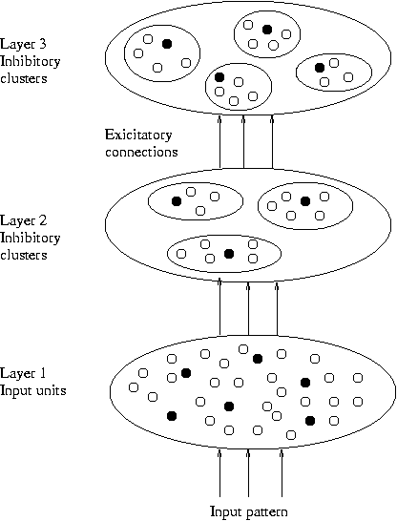
Model-Based Clustering Methods

Slide 77
Self-organizing feature maps (SOMs)
Clustering is also performed by having several units competing for the current object
The unit whose weight vector is closest to the current object wins
The winner and its neighbors learn by having their weights adjusted
SOMs are believed to resemble processing that can occur in the brain
Useful for visualizing high-dimensional data in 2- or 3-D space

Slide 78
Chapter 8. Cluster Analysis
What is Cluster Analysis?
Types of Data in Cluster Analysis
A Categorization of Major Clustering Methods
Partitioning Methods
Hierarchical Methods
Density-Based Methods
Grid-Based Methods
Model-Based Clustering Methods
Outlier Analysis
Summary

Slide 79
What Is Outlier Discovery?
What are outliers?
  The set of objects are considerably dissimilar from the remainder of the data
  Example: Sports: Michael Jordon,.....
Problem
  Find top n outlier points
Applications:
  Credit card fraud detection
  Telecom fraud detection
  Customer segmentation
  Medical analysis

Slide 80

Outlier Discovery: Statistical Approaches
Assume a model underlying distribution that generates data set (e.g. normal distribution)
Use discordancy tests to find outliers depending on
  data distribution
  distribution parameter (e.g., mean, variance)
  number of expected outliers
Drawbacks
  most tests are for single attribute
  In many cases, data distribution may not be known

Slide 81
Outlier Discovery: Distance-Based Approach
Introduced to counter the main limitations imposed by statistical methods
  We need multi-dimensional analysis without knowing data distribution.
Distance-based outlier: A DB(p, D)-outlier is an object O in a dataset T such that at least a fraction p of the objects in T lies at a distance greater than D from O
Algorithms for mining distance-based outliers
  Index-based algorithm
  Nested-loop algorithm
  Cell-based algorithm

Slide 82
Outlier Discovery: Deviation-Based Approach
Identifies outliers by examining the main characteristics of objects in a group
Objects that “deviate” from this description are considered outliers
sequential exception technique
  simulates the way in which humans can distinguish unusual objects from among a series of supposedly like objects
OLAP data cube technique
  uses data cubes to identify regions of anomalies in large multidimensional data

Slide 83
Chapter 8. Cluster Analysis
What is Cluster Analysis?
Types of Data in Cluster Analysis
A Categorization of Major Clustering Methods
Partitioning Methods
Hierarchical Methods
Density-Based Methods
Grid-Based Methods
Model-Based Clustering Methods
Outlier Analysis
Summary

Slide 84
Problems and Challenges
Considerable progress has been made in scalable clustering methods
  Partitioning: k-means, k-medoids, CLARANS
  Hierarchical: BIRCH, CURE
  Density-based: DBSCAN, CLIQUE, OPTICS
  Grid-based: STING, WaveCluster
  Model-based: Autoclass, Denclue, Cobweb
Current clustering techniques do not address all the requirements adequately
Constraint-based clustering analysis: Constraints exist in data space (bridges and highways) or in user queries

Slide 85
Constraint-Based Clustering Analysis
Clustering analysis: less parameters but more user-desired constraints, e.g., an ATM allocation problem

Slide 86
Summary
Cluster analysis groups objects based on their similarity and has wide applications
Measure of similarity can be computed for various types of data
Clustering algorithms can be categorized into partitioning methods, hierarchical methods, density-based methods, grid-based methods, and model-based methods
Outlier detection and analysis are very useful for fraud detection, etc. and can be performed by statistical, distance-based or deviation-based approaches
There are still lots of research issues on cluster analysis, such as constraint-based clustering

